Slide 1
Strategic and Change Management
Presented
by
Dennis Smith - CM(SA)
27/02/16

Slide 2
Mergers and Acquisitions
Resource allocation / Focus on Money / Adaptability / “New Brooms
/ Integration and Interdependence
M&A Process
Strategic Alliances
Managing HR
Planned Change
Consequences of Change

Slide 3
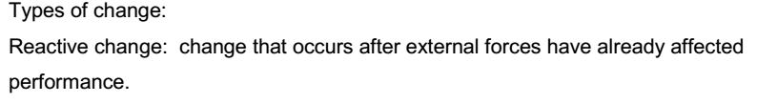
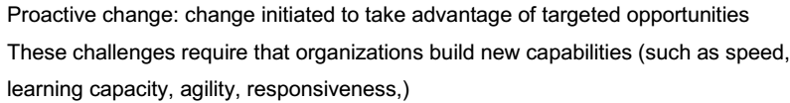
Flight of Skills / Brain Drain
HRIS

Slide 4


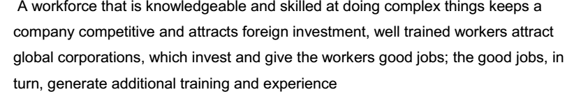
-

Slide 5
CORPORATE MERGERS
PRIMARY PURPOSE OF MERGING
To improve overall performance

Slide 6
MAJOR MERGER OBJECTIVES
Rank | OBJECTIVES
1 | Achieve growth more rapidly than by internal effort.
2 | Satisfy market demand for additional products, services.
3 | Avoid risks of internal start ups or expansion.
4 | Increase earnings per share.
5 | Acquire market share or position.
6 | Enhance the power and prestige of owner or management.
7 | Increase utilization of present resources.
8 | Acquire outstanding management or technical personnel.

Slide 7
Do Mergers Benefit the Involved Parties
The Empirical and Conceptual Literature support opposite point of views
Reconciling the Difference of Opinion
Position: I
Position: II
Mergers Do Not Provide Real Benefits
Mergers Do Provide Real Benefits
II
I
Why Do Mergers Continue?
Why Benefits have not been Detected?
Managers Make Mistakes
Managers Interest
Administrative problems may cancel out Benefits
Methodological problem to detect Benefits
Only certain types of Merger strategies benefit
Selection of merger candidates
Proper price
Change in the Size of the Firm
Prestige and power
Salaries, bonuses, stock options
Promotions

Slide 8
POTENTIAL ECONOMIC BENEFITS IN MERGERS
Scale Economics
To avoid duplication of equipment and activities and also to introduce activities which would not be justified otherwise.
Economies of Scope
A single firm can produce a given level of output of each product line at a lesser cost than that of separate firms
Pecuniary
Market power related economies

Slide 9
When Companies merge, employees face many losses including:
Hierarchical status – often the acquirer becomes “boss”.
Knowledge of firm – procedures and people change.
Trusted subordinates – people tend to be shifted around.
Network – new connections are formed.
Control – acquires usually make the decisions.
Future – no one knows what will happen.
Job definition – most things are in flux for a while
Physical location – moving is typical in mergers.
Friends or peers – often people leave, are fired, or transferred.

Slide 10
Issues to be considered before the merger:
OWNERS
DETERMINE MERGER OBJECTIVES: IN ORDER TO FACILITATE TYPE OF MERGER NEEDED AND IMPLEMENTING STRATEGY ACCORDINGLY.
OUTSIDE
SPECIALISTS
FIRM VALUATION PROCESS.
SELL NOT TELL
APPROACH
COMMUNICATION PROGRAMS/PRACTICES AT PRE-THROUGH-AFTER MERGER ANNOUNCEMENT.
FUTURE MANAGEMENT
OF THE NEWLY FORMED CO.
ESTABLISHMENT OF MERGER INTEGRATION TEAM.
WIN-WIN APROACH
BEST OF EACH
CULTURAL COMPATIBILITY.
TEAM BUILDING CHANGE
TECHNIQUES CREATIVE IDEAS
THE PRESENCE OF A CONSULTANT.
MAKE TOUGH DECISIONS QUICKLY AND BE TRUTHFUL WITH PEOPLE.

Slide 11
Important definitions for firm valuation
What would each side contribute along the following dimensions:
The Strategic Issues
- What is your distinct competency?
- Estimated cash flow after merger.
- Expected earnings after merger.
- Financial stand for the mother company of each.
The Managerial Issues
- Level of experience accumulated for each side.
- Existing human resources in each side’s business line up for merger.
The Operational Issues
- Marketing capabilities
- Sales point (locations and number)
- Manufacturing capabilities (if it is a manufacturing co.)
The Financial Issues
- Assets of the intended merging business line
- Financial strength of the intended business line

Slide 12
Purpose, timing, and types of facilitation at appropriate points during merger
Type | Preliminary |  | Primary |  | Secondary
Individuals | Active listening One-on-one support Stress reduction Role validation Social support |  | Career counseling Reality testing Examining assumptions Personal strategizing Role recognition |  | Confrontation Feedback Adaption Counseling Coaching /Outplacement
Groups | Listening Mourning the loss Reassurance of value Sharing common concerns Small group discussions |  | Information exchange Intergroup mirroring Joint action planning Norms and values Clarification Mission and goals / Intergroup contracts |  | Action research Intergroup Interpersonal problem solving Joint evaluations Adjustment planning
Organization | Symbolic exercises Employee meetings Union/management Conferencing Integration management workshops / Q & A meetings |  | Translation teams Communication planning Exchanging literature Newsletter bulletins Corporate culture presentations Integration planning |  | Employee surveys and feedback Sensing sessions Integration reviews Formulating new corporate philosophy, values, principles
Rumors Announcement Preparation Merger Integration Evaluation
Timing |  | Pre-merger phase (3-6 months) |  | Merger phase (3-4 months) | Post-merger phase (6-18 months)

Slide 13
Effectiveness of the assimilation process
Organizational Compatibility
- Similarity in management style.
- Organizational reward and control system.
- Organization cultures, etc.
Personal and Motivational Issues
- Autonomy granted to the acquired firm.
- Adequacy of communication.
- Extent of top management involvement in the assimilation process.

Slide 14
Post Merger Integration Tasks
 | Coordination | Control | Conflict Resolution
Procedure | - Design accounting system and procedures | - Design management controlling system | Eliminate contradictory rules and procedures Randomize systems
Physical | - Encourage sharing of resources | - Measure and manage the productivity of resources | Resource allocations Asset redeployment
Managerial and Socio cultural | Establish integrator roles Change organization structure | Design compensation and reward systems Allocate authority and responsibility | Stabilize power sharing

Slide 15
Reasons for Building a Strategic Alliance - rather than rely on internal growth:
1. Build global market capabilities
2. Cope with escalating research and development costs
3. Pre-empt competitive threats
4. Speed up product innovation
5. Cope with the integration of technologies and markets
6. Build world class capabilities
7. Establish global standards
8. Jump market barriers in emerging markets and regional trading areas
9. Cut exit costs
10. Take opportunities from the greening of global business

Slide 16
Managing Strategic Alliances brings difficulties and raises issues
Planning and control considerations
Human resource management
Cultural differences
Challenges and obstacles

Slide 17
Lorange and Roos (1992) identify seven challenges which managers have to meet:
how to overcome reluctance to give up autonomy over partner’s own resources
how to achieve operating momentum
how to focus on external environment (customers, competition) rather than internal friction
how to avoid unnecessary politicking
how to maintain energy and commitment over time
how to increase the willingness to learn
how to prevent particular individuals from becoming bottlenecks

Slide 18
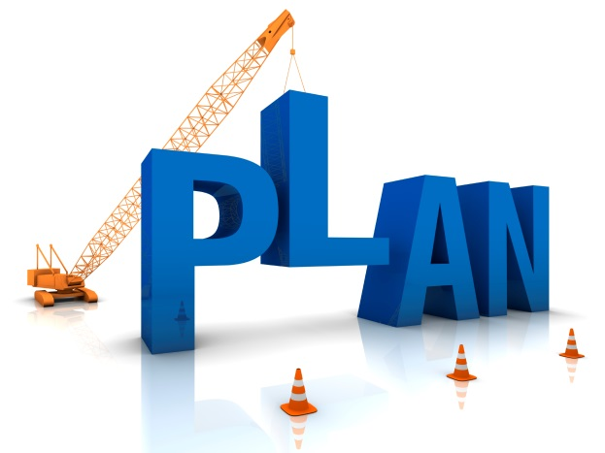
My favourite saying…
Fail to plan, Plan to Fail.

Slide 19
What is Change Management?
Prosci’s definition of change management: Change management is the application of a structured process and set of tools for leading the “people side” of change to achieve a desired outcome.
When change management is done well, people feel engaged in the change process and work collectively towards a common objective, realizing benefits and delivering results.

Slide 20
“Change is the name of the game in management today.”
Harvey and Brown (1996: 30)
Planned change is often initiated and implemented by managers, often with the assistance of a change agent.

Slide 21
Management Approaches to Change
Hyper turbulent
Reactive management is a style of reacting to a stimulus after conditions in the business environment have changed.
. Organisations that exist in a hyper turbulent environment must go beyond reacting to a situation but must innovate as a result.
Environmental
Stability
management characterised by a centralised decision-making structure with problems being referred to senior management
management style favouring low risk, formal procedures with a high degree of structure and control.
Figure 8.1: Model of Adaptive Orientation in Organisations
Source: (Harvey and Brown 2006:38)

Slide 22
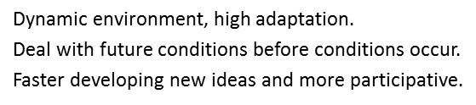
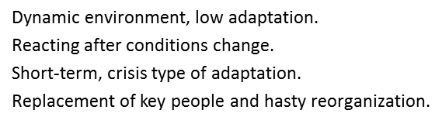
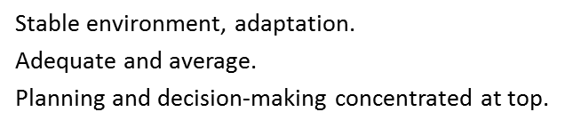
Model of Adaptive Orientation
A hyper-turbulent environment is characterized by rapid changing product lines, and increasing and changing set of competitors, rapid and continual technological innovation, and rapid market growth.
Low risk / Highly structured / controlled / more mgmnt levels / tradition / unwilling to accept new ideas / future problems

Slide 24
The Systems Approach to Organisational Change
Changes in any part of the system have a reverberating effect on all other parts of the system.
The Systems Approach provides a conceptual framework for integrating the various components within the system and for linking its subsystems with larger organisational needs

Slide 26
Open Systems Anchor of OB
Feedback
Feedback
Inputs
Outputs
Subsystem
Subsystem
Organization
Subsystem
Subsystem

Slide 27
Basic Qualities of Systems
Designed to accomplish objectives.
Established arrangement.
Interrelationships exist among elements.
Process more vital than basic elements.
Organization more important than elements.
System consists of inputs, processes, outputs.

Slide 28
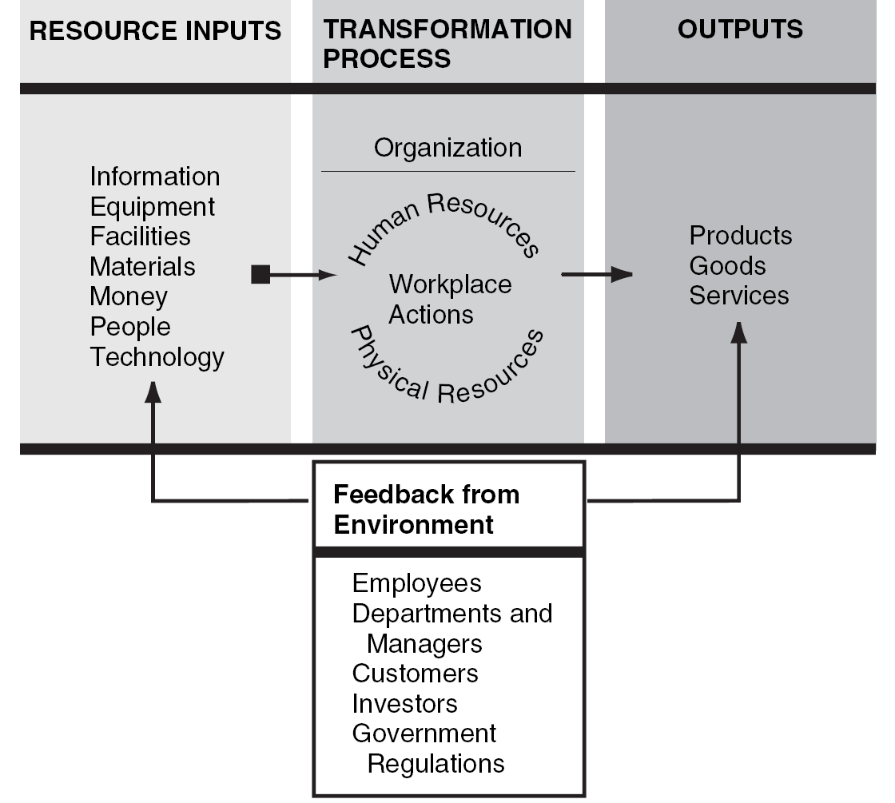
Figure 2.2 Organization as Open System

Slide 29
The Sociotechnical System
Coordinated human and technical activities.
Consists of: Goals and values./ Technical subsystem. / Structural subsystem.
Psychosocial subsystem (culture). / Managerial subsystem.

Slide 30
High Performance Systems
Occur by design—not by chance.
Key variables are:
Business situation
Strategy
Design elements
Culture
Results

Slide 31
Contingency Theory and Future Shock.
The Contingency Approach is based on Systems Theory and its basic premise is that there is no single best way to manage.
Managers must, therefore, be flexible and adapt to the contingencies that are present or reflected in:
1. their external environments,
2. the organisation’s own capabilities,
3. employees’ values, goals, skills and attitudes, and
4. the technology used by the organisation.
Future Shock

Slide 32
Contingency Approach
Considers organization and environment.
Identifies “if-then” relationships.
Suggests change directions.

Slide 33
Future Shock and Change
Too much change in too short a time.
Inability to adapt to accelerating rates of change.
Management reaction to change strained.
Managers must be adaptable and flexible.

Slide 34
Table 2.2 Millennial Megatrends: Gateways to Twenty-first Century

Slide 35
Strategies For Change Management
Empirical­ Rational
People are rational and will follow their self­ -interest once a change is revealed to them. Change is
based on the communication of information and the proffering of incentives.
Normative­ -Reductive
People are social beings and adhere to cultural norms and values. Change is based on redefining and reinterpreting existing norms and values, and developing people’s commitments to new ones
Power­ - Coercive
People are basically compliant and will generally do what they are told or can be made to do. Change is based on the exercise of authority and the imposition of sanctions.
Environmental­ Adaptive
People oppose loss and disruption, but they adapt readily to new circumstances. Change is based on building a new organization and gradually transferring people from the old one to the new one

Slide 36
Change Factors

Slide 37
Factors in selecting a Change Strategy

Slide 38
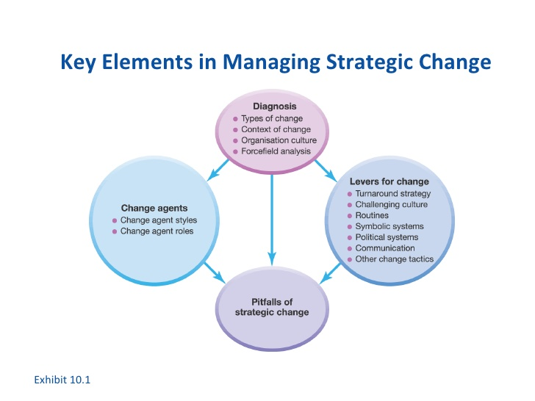

Slide 39
Thank You

